Slide 1
BITCOIN PRICE PREDICTION USING DEEP LEARNING
SUBMITTED BY : UNDER THE GUIDANCE OF:
ESHA MAHENDRA(9916102024) DR. SAJAIVIR SINGH
HARSHITA MADAN (9916102069)
SHIVANGI GUPTA (9916102126)

Slide 2
TABLE OF CONTENTS
ABSTRACT
INTRODUCTION TO BITCOIN
WHAT IS DEEP LEARNING?
LITERATURE SURVEY
PROJECT GOAL
WORKFLOW
ALGORITHMS USED
RESULTS AND DISCUSSION
CONCLUSION
REFERENCES

Slide 3
ABSTRACT
The rapid development of digital currencies during the last decade is one of the most controversial and ambiguous innovations in the modern global economy.
Wide fluctuations in cryptocurrency price indicate an urgent need for an accurate way to forecast this price.
The deep learning techniques have gained increasing popularity for its performance by predicting the bitcoin prices by considering their non-linear nature.

Slide 4

INTRODUCTION TO BITCOIN
Cryptocurrency is an internet-based medium of exchange which uses cryptographic functions to conduct financial transactions.
Bitcoin is the world’s largest cryptocurrency launched in 2009. It is a decentralized digital currency without a central bank that can be sent from user to user on the peer to peer bitcoin network without the need of intermediaries.
1 Bitcoin equals 7,21,342.47 Indian Rupee.

Slide 5
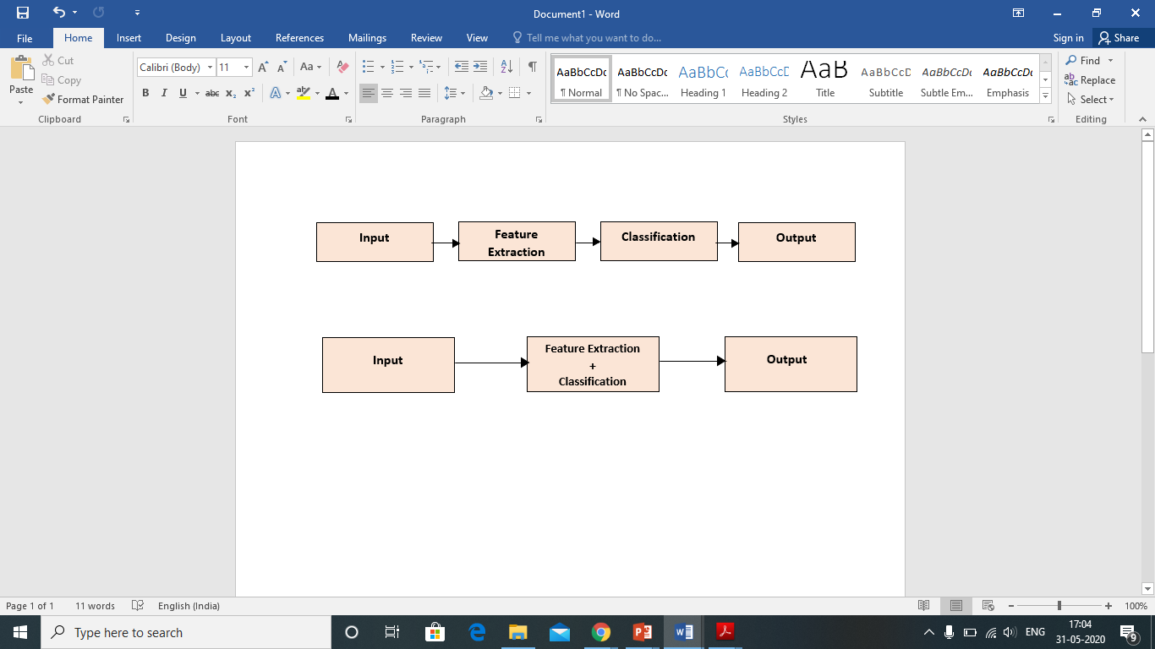
WHAT IS DEEP LEARNING?
Deep learning is a subset of machine learning in artificial intelligence (AI) that has networks capable of learning unsupervised from data that is unstructured or unlabeled.
Learning can be supervised, unsupervised or semi-supervised. The deep learning architectures such as RNN,DBN,CNN have been applied in various fields.[1]
Fig 1. Difference between ML and DL[1]

Slide 6
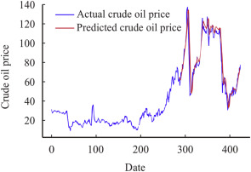
LITERATURE SURVEY
1. Forecasting Crude Oil Price
The deep learning model has been used to capture the unknown complex non-linear characteristics of crude oil price movements.[2]
It contributes to literature by providing new methodology on how the deep learning models DBN and LSTM has been used to improve the crude oil forecasting accuracy.
Fig 2. Graph showing the actual and predicted crude oil price[2]

Slide 7
2. Price Prediciton Using CNN:
CNN architecture was used to predict the bitcoin price.
The website was designed using Django framework to request online database through an API.
The experimental results show that the CNN model took a long time in training of data and performance was also low. This was because the CNN architecture lacks internal memory.[3]
Fig 3. Prediction Graph Window.[3]

Slide 8
PROJECT GOAL
The main objective of our project is to analyse dataset and train a model that can predict the bitcoin price using deep learning models which are effective for training time-series data.
The study is also been carried out to prove that ML models can’t be used for training sequential data i.e. Time series data as they have very low accuracy.[4]
The model built has been deployed to the website using Flask.
The proposed approach is implemented in Python and validated for benchmark datasets.

Slide 9
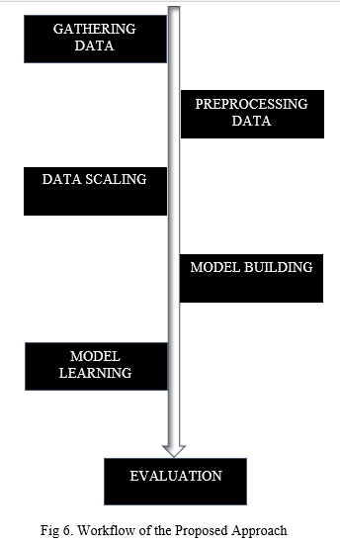
WORKFLOW
Our project is basically divided into two parts: Firstly, Finding the suitable Deep learning model for prediction and then its deployment using Flask.
The following processes are carried out as shown in the flowchart.
Evaluation is done by plotting graphs and calculating RMSE values.[5]
Fig 4.Flowchart of the Proposed Approach

Slide 10
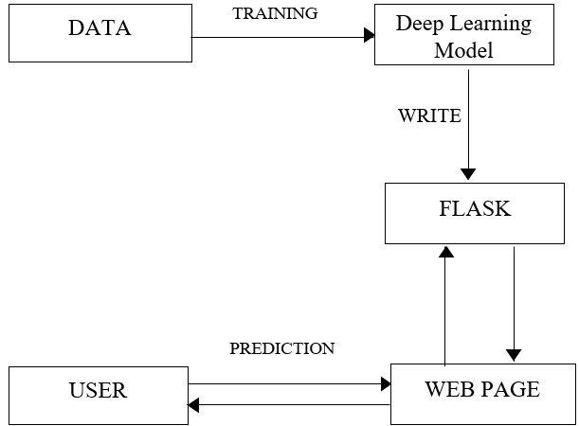
Deployment of Deep Learning Model requires the following steps:
The first thing is to make the front end web app using HTML for the user to input the values. [6]
The API is created which receive the price details through GUI and computed the predicted sales value based on the model. The POST request is used in prediction and then showing the results.
Finally, the request module is used to call API’s defined in the previous file which displays the result.
Fig 5. Flowchart of Model Deployment[6]

Slide 11
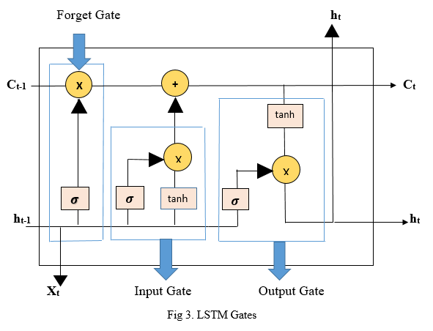
ALGORITHMS USED
1. LONG SHORT TERM MEMORY(LSTM):
Fig 6. LSTM Gates
The above figure shows the LSTM unit consisting of the three gates ,X_{t} represents the current input while h_{t} represents the current hidden state calculated. h_{t-1} represents the previous hidden state which is most important in deciding which values are to be updated in current state and C_{t-1} denotes the cell state of previous time step.[7]

Slide 12
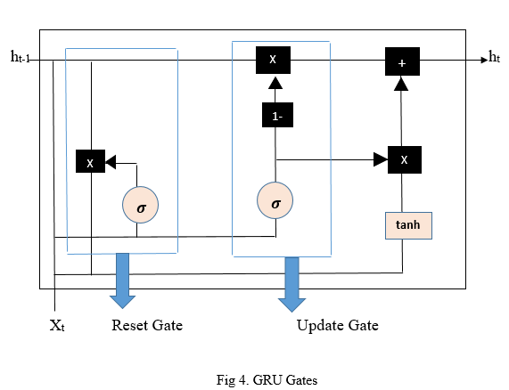
2. GATED RECURRENT UNIT(GRU):
Fig 7. GRU Unit
Gated Recurrent Unit is the advance version of LSTM neural architecture.
In the above GRU unit cell, h_{t-1} represents the hidden state of previous time step, X_{t} represents the input value of data in current time step and h_{t} represents the hidden state of current time step which would be passed to next time step. The reset gate performs the operation which the input and the forget gate does in LSTM .[8]

Slide 13
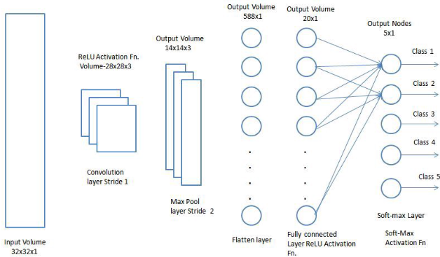
3.CONVOLUTIONAL NEURAL NETWORK (CNN):
Fig 8. CNN Architecture[9]
The architecture of CNN is similar to fully connected networks as that of neurons inside the brain.
Convolution Layer: This layer detects the set of features received as input.
Pooling Layer: This layer reduces the computation power required to process the data.
ReLU Correction Layer: This layer acts as an activation layer by changing all the values from negative to zero.[9]
Fully connected Layer: This type of layer receives the input vector and the output vector is produced by applying the linear combinations.

Slide 14
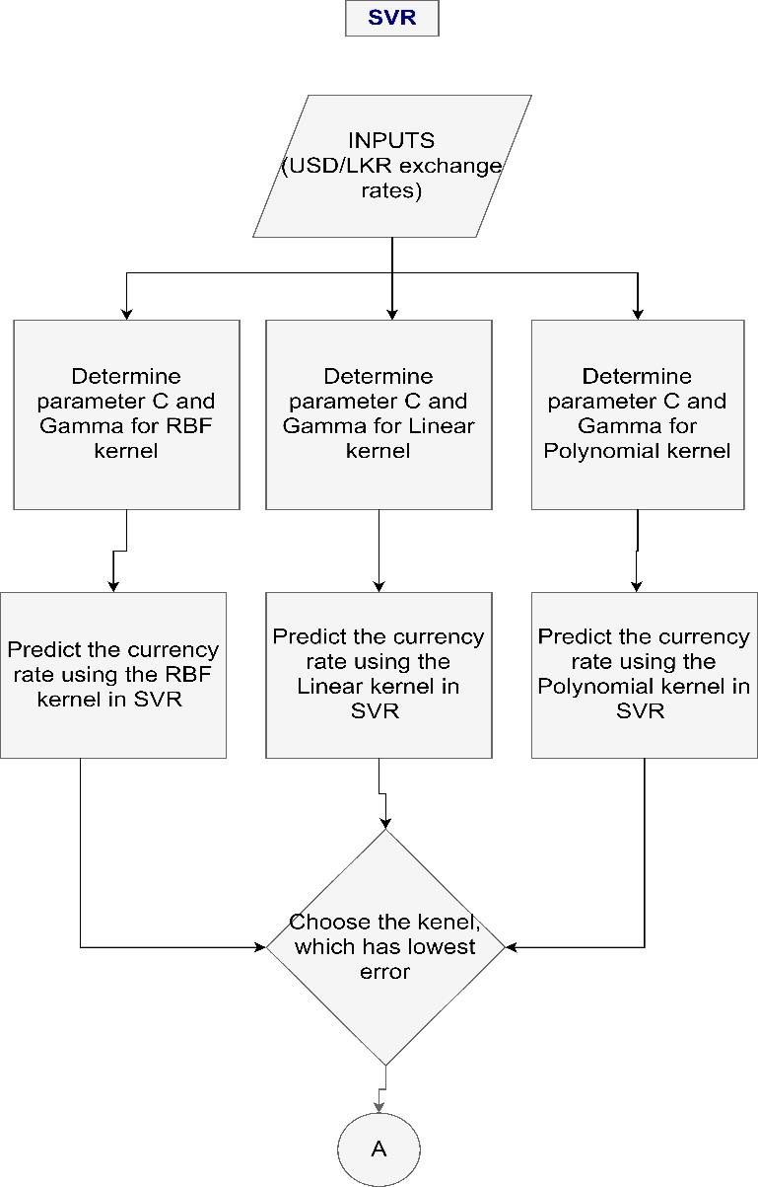
4.SUPPORT VECTOR MACHINE(SVM):
This algorithm can both be used in classification as well as regression problem.
In the project, support vector regression function is used for analyzing data for regression analysis.[10]
This algorithm also has more classification errors as compared to other neural network and doesn’t perform well with the continuous sequential data.
Fig 9. SVR flowchart

Slide 15
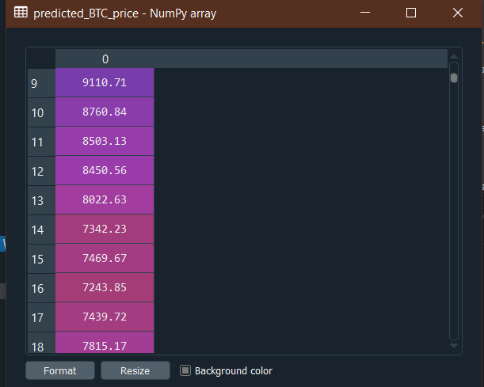
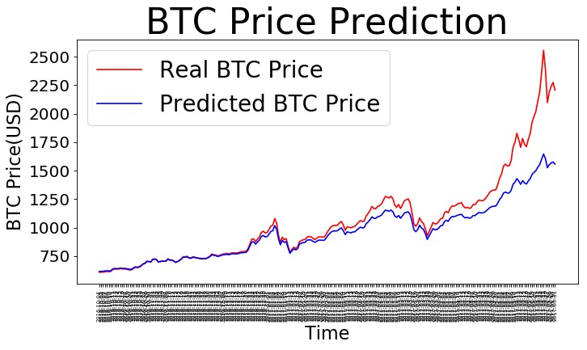
RESULTS AND DISCUSSION
The above shown images represent predicted output cells of LSTM model and plot between time and price respectively. LSTM Model has the RMSE of 0.014.

Slide 16
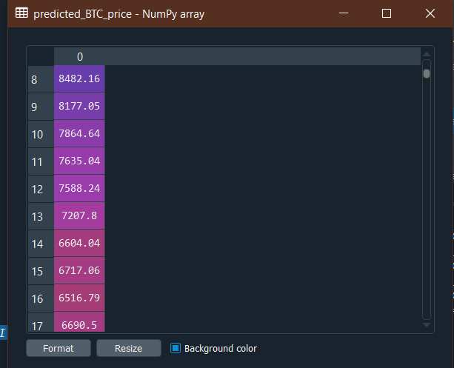
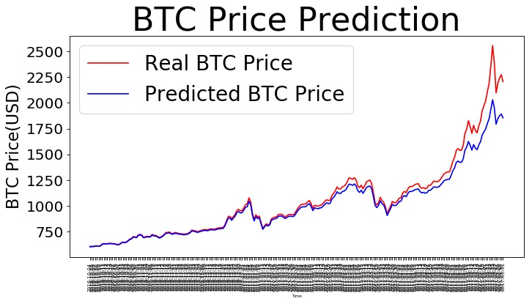
The above shown images represent predicted output cells of GRU model and plot between time and price respectively. GRU Model has the RMSE of 0.022.
This shows it is better as compared to LSTM.

Slide 17
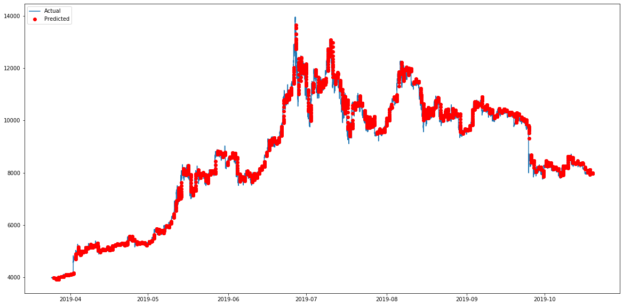
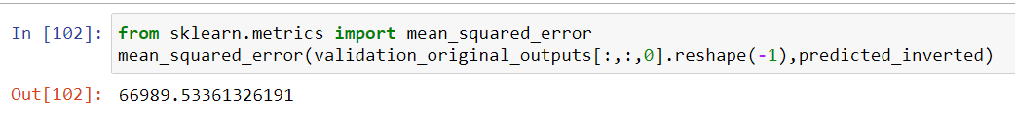
The above shown images represents plot between time and price using CNN model and mean square error respectively.

Slide 18
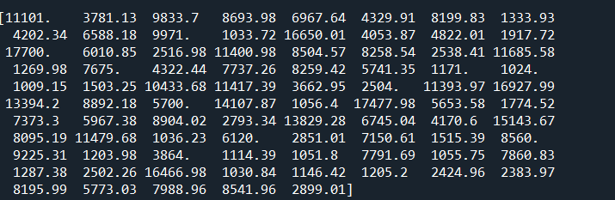
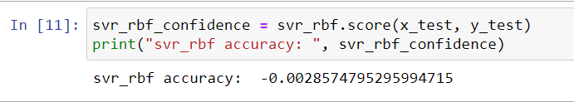
The above images represent the predicted output matrix and accuracy using SVM model. It is very clear that SVM doesn’t work well in time series data.

Slide 19

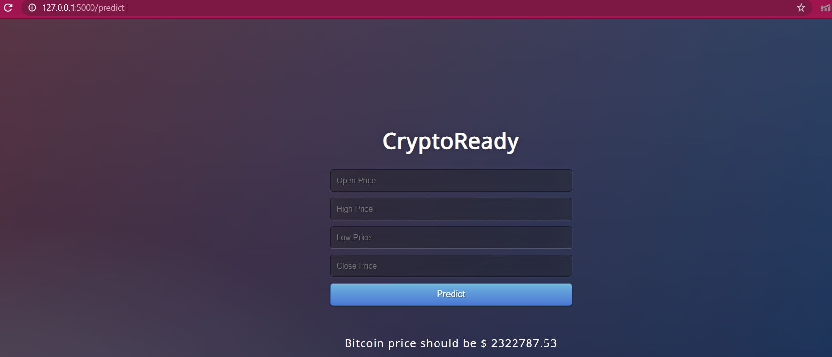
Above images represent the API Window while giving inputs and obtaining result respectively.

Slide 20

CONCLUSION
It can be inferred that deep learning models take long time to train.
Prediction of bitcoin price was a complicated task as it is based on large dataset.
No. of neurons can be increased. Dataset of large columns will be of better results. Including more features or parameters is always for betterment.
Deployment of model using flask API can be seen as work in production.

Slide 21
REFERENCES
[1] Y. Yao, J. Yi, S. Zhai, Y. Lin, T. K. G. Zhang, L. Yoonjae Lee “ Predictive Analysis of Cryptocurrency Price Using Deep Learning” International Journal of Engineering & Technology, pp: 258-264, 2018
[2]M.Bristone, R. Prasad “Crude oil price prediction using complex network and deep learning algorithms”, African University of Science and Technology, Abuja, Nigeria, pp:1-9, November 2019.
[3] S. Yogeshwaran, M. J. Kaur, P. Maheshwari “Predicting Bitcoin Prices using Deep Learning”, IEEE Global Engineering Education Conference (EDUCON), pp: 1449-1454, April 2019
[4] S. Velankar, S. Valecha, S. Maji, “Bitcoin Price Prediction using Machine Learning”, International Conference on Advanced Communications Technology, pp:144-147, Feb 2018
[5] F. Tschorsch, B. Scheuermann, “Bitcoin and beyond: A technical survey on decentralized digital currencies”, IEEE Communications Surveys & Tutorials Vol.18 No.3, pp:2084-2123, 2016.
[6] F. A. Aslam, Mohammed, “Efficient Way of Web Development Using Python and Flask”, International Journal of Advanced Computer Research Vol.6, pp:54-57, January 2015.
[7]P. Meesad, R.I Rasel, “An efficient modelling approach for forecasting financial time series data using support vector regression”, International Journal of Computational Intelligence StudiesVol.4 No.2, pp:134-150, January 2015.
[8] https://www.kaggle.com/atuljhasg/bitcoin-price-prediction-using-rnn
[9]https://medium.com/swlh/how-i-used-ml-to-predict-bitcoin-prices-82af7c655092
[10]https://www.analyticsvidhya.com/blog/2017/09/machine-learning-models-as-apis-using-flask

